Slide 1

Intelligent Tweet Analyzer for disaster management
Hetal Mahajan- 21106014
Christina D’Cruz-22106024
Prabudh Gaikwad-2116038
Project Guide
Dr. Rahul K Ambekar

Slide 2
INTRODUCTION
Social media (e.g., Twitter) becomes a critical real-time information channel.
Large volumes of tweets make it difficult to manually identify urgent and actionable information.
The system performs sentiment analysis, urgency scoring, and geolocation tagging
It supports faster decision-making and efficient disaster response.
It uses Generative AI to analyze disaster-related tweets automatically.

Slide 3
OBJECTIVE
To Extract and Tag Locations: Automatically identify and extract geographic locations mentioned in tweets to map affected areas and improve situational awareness.
To Detect Affected Zones: Use tagged locations to highlight clusters of incidents, enabling early detection of crisis hotspots and faster resource allocation.
To Assess Urgency Levels: Implement urgency scoring mechanisms to classify tweets based on severity, ensuring that high-priority cases receive immediate attention.
To Analyze Sentiment for Distress Signals: Apply sentiment analysis to detect emotions such as fear, panic, or distress in tweets, supporting faster and more empathetic emergency response.

Slide 4
Literature Survey of the Existing System
Sr. No. | Paper Title | Authors | Review
 | Twitter analysis in emergency management: recent research and trends 2024 | Alireza Arvandi, Jon Rokne, Reda Alhajj | This review explores Twitter's role in emergency management, focusing on data collection, preprocessing, and information extraction from tweets during disasters, highlighting their timely, on-site guidance.
2. | Social response and Disaster management: Insights from twitter data Assimilation on Hurricane Ian 2023 | Mohammadsepehr Karimiziarani, Hamid Moradkhani | This paper uses NLP techniques to analyze 20 million tweets from Hurricane Ian, classifying humanitarian content and exploring public responses, providing insights for disaster preparedness and response strategies.

Slide 5
3. | Twitter for disaster relief through sentiment analysis for COVID-19 and natural hazard crises 2021 | Shivam Behl, Aman Rao, Sahil Aggarwal, Sakshi Chadha | The study compares supervised learning models, focusing on a Multilayer Perceptron for classifying tweets into resource needs, availability, or neutral categories, achieving 83% accuracy.
4. | Disaster Analysis Through Tweets 2015 | Himanshu Shekhar, Shankar Setty | The paper introduces a tweet-based interface for natural disaster analysis, utilizing sentiment classification to gauge distress levels, visualize emotions, and provide a cost-effective alternative to traditional methods.
3. | Twitter for disaster relief through sentiment analysis for COVID-19 and natural hazard crises 2021 | Shivam Behl, Aman Rao, Sahil Aggarwal, Sakshi Chadha | The study compares supervised learning models, focusing on a Multilayer Perceptron for classifying tweets into resource needs, availability, or neutral categories, achieving 83% accuracy.
4. | Disaster Analysis Through Tweets 2015 | Himanshu Shekhar, Shankar Setty | The paper introduces a tweet-based interface for natural disaster analysis, utilizing sentiment classification to gauge distress levels, visualize emotions, and provide a cost-effective alternative to traditional methods.

Slide 6
5. | Usage and analysis of Twitter during 2015 Chennai flood towards disaster management | Meera R. Nair , G.R. Ramya , P. Bagavathi Sivakumar | This study uses machine learning algorithms like Random Forests to analyze tweet propagation during the 2015 Chennai flood, identifying influential users and sources, highlighting social media's role in crisis information dissemination.

Slide 7
Limitations of Existing Systems
Noisy and Unstructured Data: Twitter data often contains slang, abbreviations, emojis, spelling mistakes, and irrelevant content. This makes it difficult to accurately process and extract meaningful disaster-related information.
Limited Applicability Across Disasters:Models trained on specific disaster types (like floods or earthquakes) may not perform well for other types of disasters due to differences in vocabulary, context, and patterns.
Language and Data Bias:The system may work better for widely used languages (like English) and may underperform for regional or low-resource languages. Biased or imbalanced datasets can also affect prediction accuracy.
Privacy and Ethical Issues: Collecting and analyzing social media data may raise concerns about user privacy, data misuse, and ethical handling of sensitive information during emergencies.

Slide 8
PROBLEM STATEMENT
During disasters, a significant volume of tweets is generated, which often contain unstructured and noisy information, making it challenging to quickly identify genuine emergency messages. The current manual monitoring approach is inefficient, and there is a lack of automated systems for extracting critical details and locations. Thus, there is a need for an intelligent system to analyze and classify disaster-related tweets in real time.

Slide 9
System Design and Proposed System
AI powered tweet analysis
AI powered scoring engine
Categorizing tweet
Location extractor

Slide 10
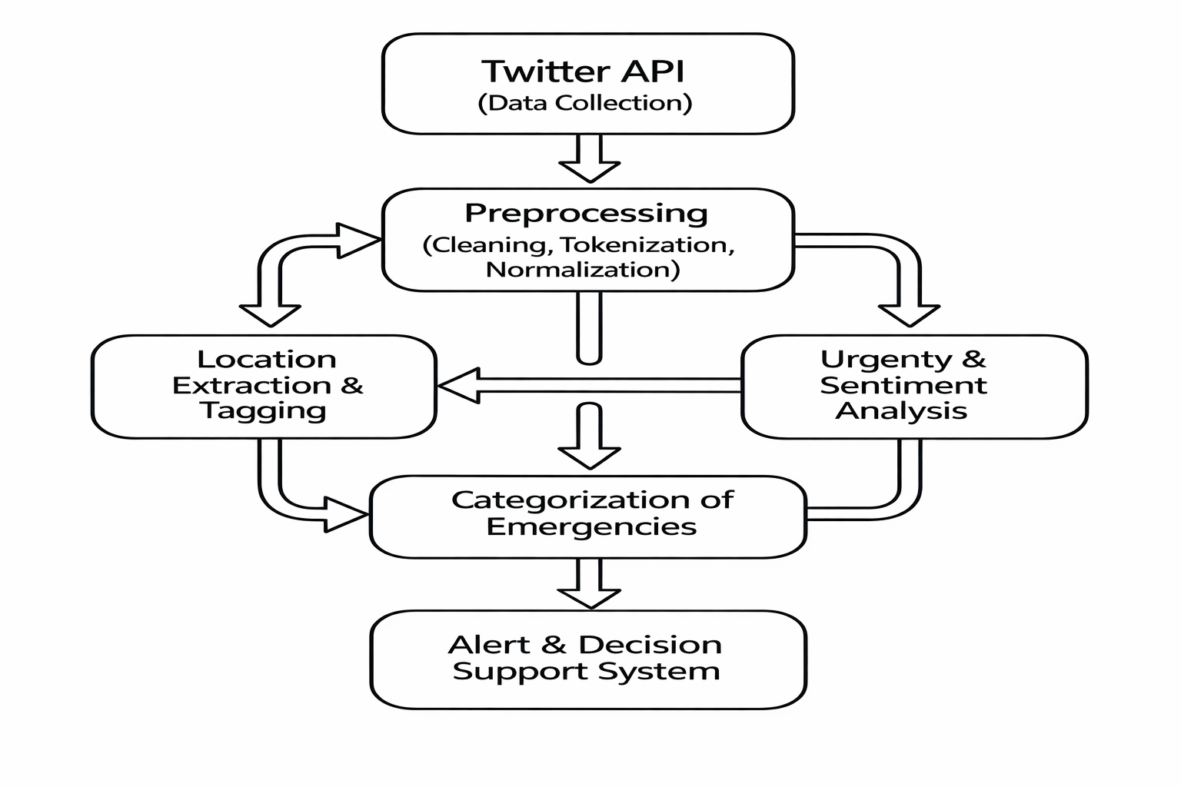
BLOCK DIAGRAM

Slide 11
TECHNOLOGIES USED
Programming Languages: Python 3.10+, JavaScript (for front-end)
Web Frameworks: FastAPI (backend API), React.js (frontend)
Database: MongoDB (for raw and processed tweet data)
Visualization Tools: Plotly , Matplotlib, Seaborn (for charts and heatmaps)
APIs: Twitter API (data collection), Google Gemini API (AI/NLP processing), Google Maps API (geolocation) , RSS(Really Simple Syndication) for disaster management feed
Development Tools: Visual Studio Code, GitHub Codespaces
Version Control: Git & GitHub for collaborative development and version tracking

Slide 12
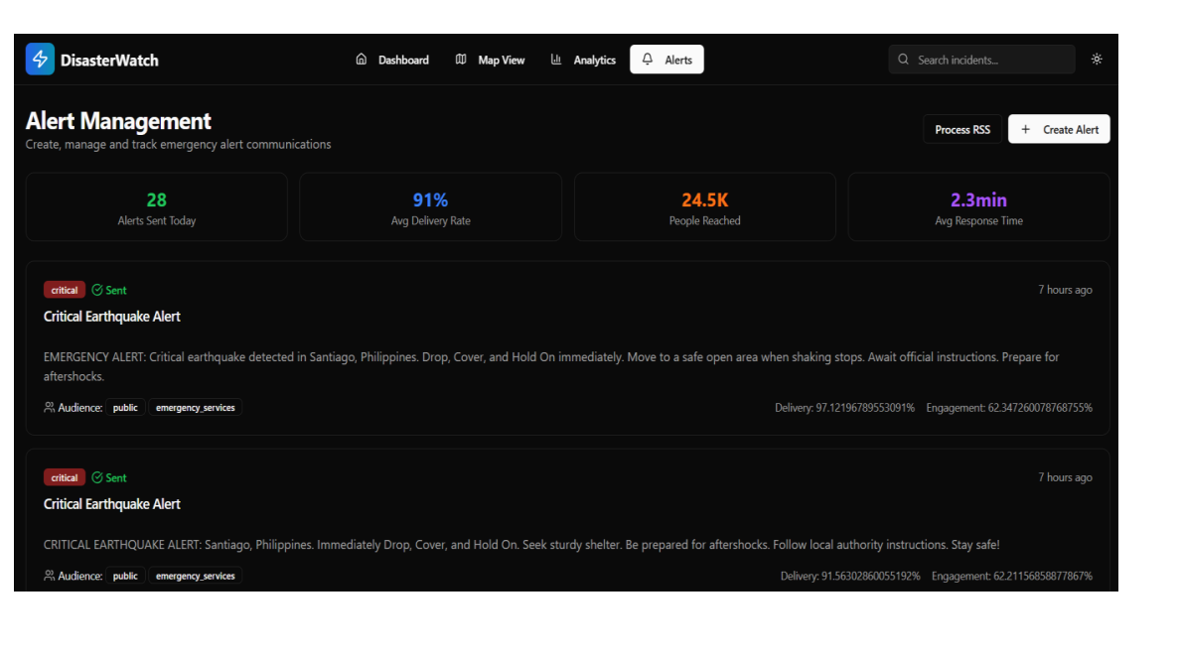
IMPLEMETATION AND OUTPUT

Slide 13
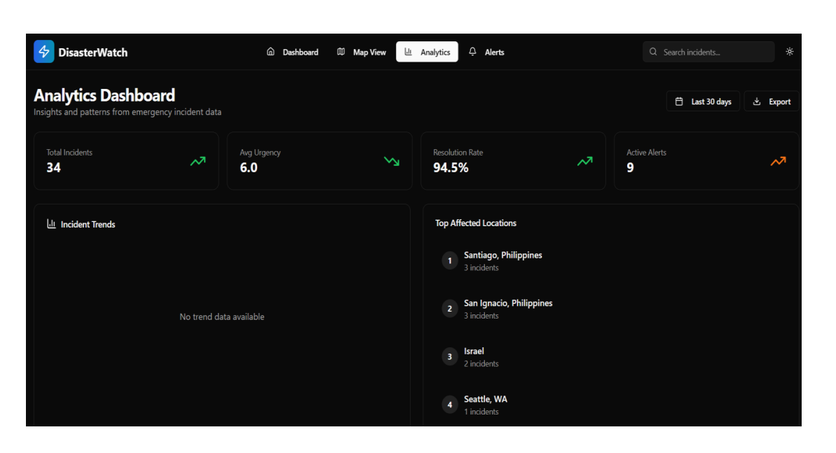

Slide 14
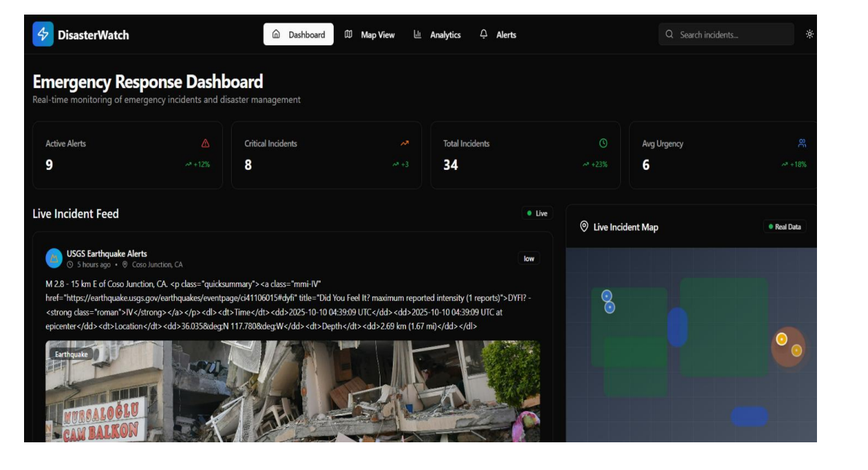

Slide 15
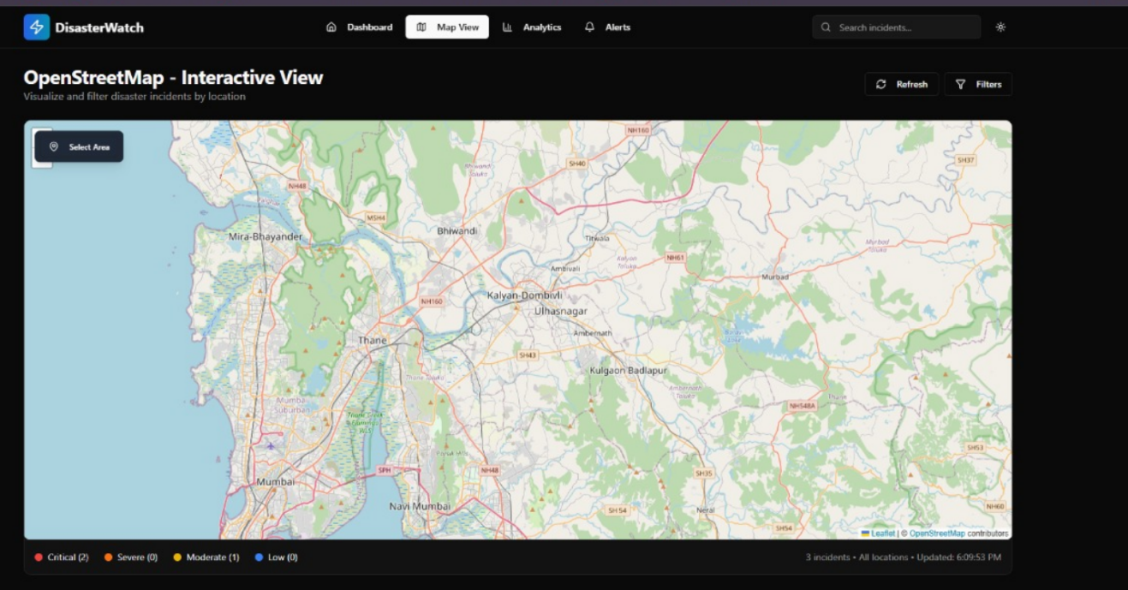

Slide 16
GOAL ALIGNMENT
SDG 16: Peace, Justice, and Strong Institutions
SDG 11: Sustainable Cities and Communities
SDG 9: Industry, Innovation, and Infrastructure

Slide 17
CONCLUSION
It GenAI to analyze real-time Twitter data.
Classifies disaster-related tweets and evaluates urgency and sentiment.
Integrates geolocation for better situational awareness.
Helps in faster decision-making and prioritizing critical incidents.

Slide 18
REFERENCES
[1] https://link.springer.com/article/10.1007/s13278-024-01308-8
[2]https://www.researchgate.net/publication/281768488_Disaster_Analysis_Through_Tweets
[3] https://www.sciencedirect.com/science/article/pii/S2212420921000674
[4] https://www.sciencedirect.com/science/article/pii/S221242092300345X
[5] https://www.sciencedirect.com/science/article/pii/S1877050917319038

Slide 19
Thank You...!!

